Slide 1
SPEND ANALYTICS
KPMG Capstone project -1
Done by,
Ishwarya M

Slide 2
Objectives:
1. Analyze the data and identify purchasing trends and patterns
2. Identify the cost saving opportunities by using the data of procurement
3. Cluster items that have similar purchasing patterns
4. Create dashboards using any Visualization tool; e.g. Tableau
5. Make a report describing all the findings.

Slide 3
Work Flow
Data Collection
Data Extraction
Data Preprocessing
Data analysis
Time
series
Forecasting
Clustering

Slide 4
Data Collection
The data we use here is collected from SAP and exported into Excel file(.xlsx format)
We have been provided with a single file which contains data related to procurement transactions for the organization, with several features for analysis.
It has totally
65 Columns
151412 Rows

Slide 5
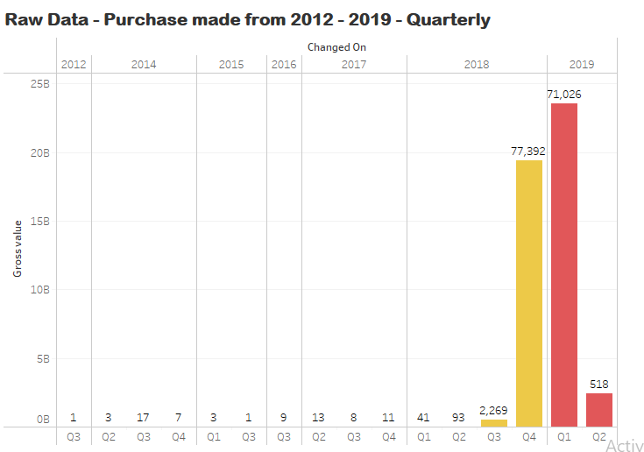
Data Extraction
In this process we extracted the columns which are significant for our analysis purpose.
Data's are available since 2012 till 2019 however there is no connectivity till 2016 and 2017 has very less volume of purchase. Hence, 2018 and 2019 were considered / extracted for the purpose of Analysis.

Slide 6
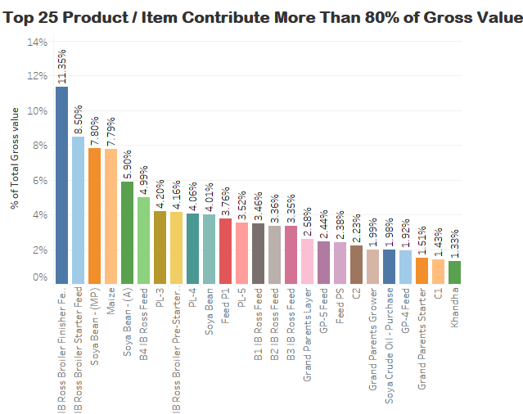
Data was further drilled down and Top 25 Products / Item (Short Text) that contributes to 80% and above of Total Gross Value were extracted using MS Excel.
There were Missing Values in the Material column however during the above extraction process the rows containing missing values were removed based on the criteria given.
Finally we gotten a data with 68523 Rows and 11 Columns.

Slide 7
Data Preprocessing
This entire Data preprocessing is done by using Pandas library in Python.
Initially done Type casting the columns to its respective Data types
Checked for missing values. The data has no missing values
Then we add new column called Net price by dividing Gross Value with the PO quantity of our original data.

Slide 8
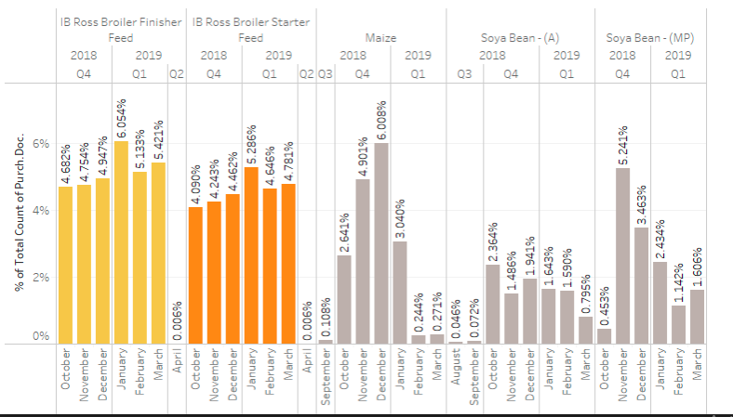
Data Analysis
Similar purchase pattern were visualized – IB Ross Broiler Finisher Feed and IB Ross Broiler Starter Feed has similar purchasing pattern during Q4 2018 & Q1 2019 and the same was also proven using clustering techniques.

Slide 9
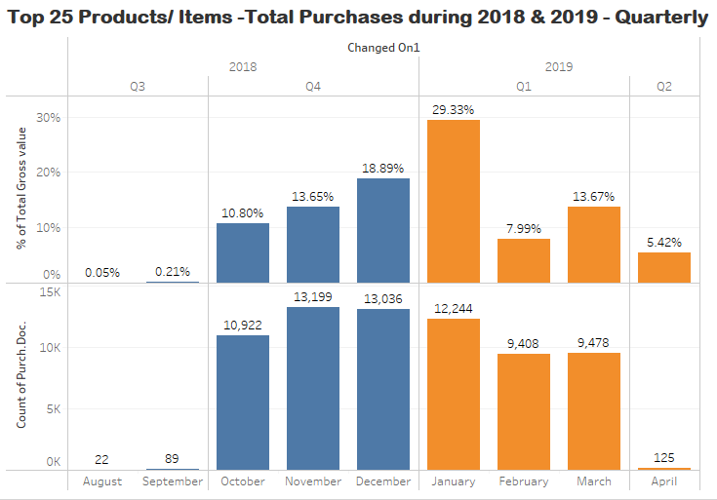
Quarter wise Analysis
Analysis were performed on the data extracted (Rows – 68523 & 12 column (includes 1 new column added during preprocessing)) and the observations are as below.
Huge volume of Purchases were made during the year 2018 & 2019, specifically in Q4 2018 & Q1 2019.
In Q2 2019 very few purchases were made on 9th April 2019.

Slide 10
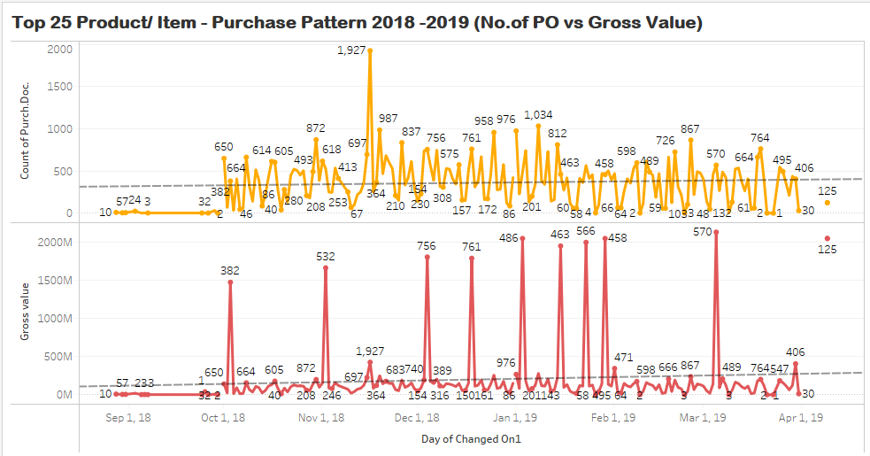
Day wise Analysis
Further drill down day wise helps to view the spike in purchase since 1st October 2018 till 31st March 2019 and the highest number of Purchase Order were raised on 4th November 2018 with a count of 1927.
Net price of few products like Soya Bean, Soya Bean (A), Soya Bean(MP), Soya Crude Oil are on the higher side, though the number of Purchase order raised was less the Gross Value has seen a spike.

Slide 11
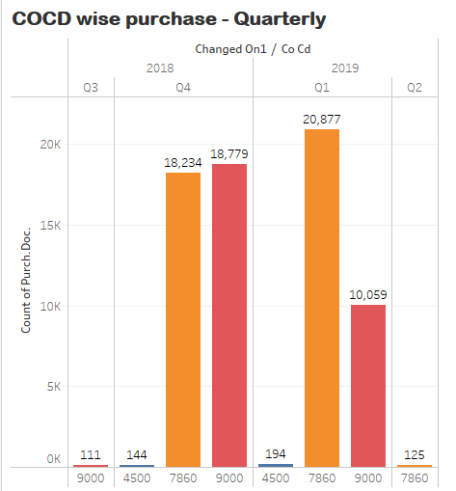
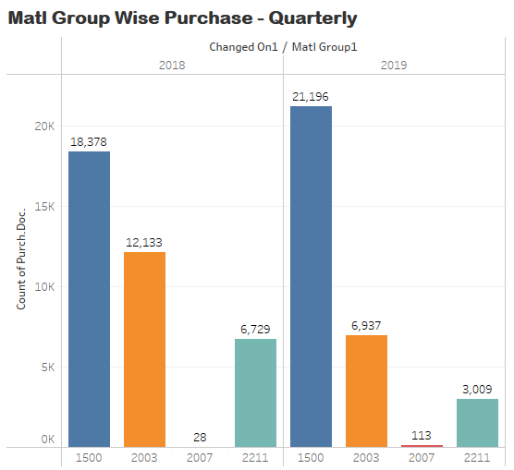
Purchase location and Material group Analysis
Purchases were made by different sub locations of COCD -4500,7860,9000.
Products /Items purchased falls under 4 Material Group (1500,2003,2007 & 2211)

Slide 12
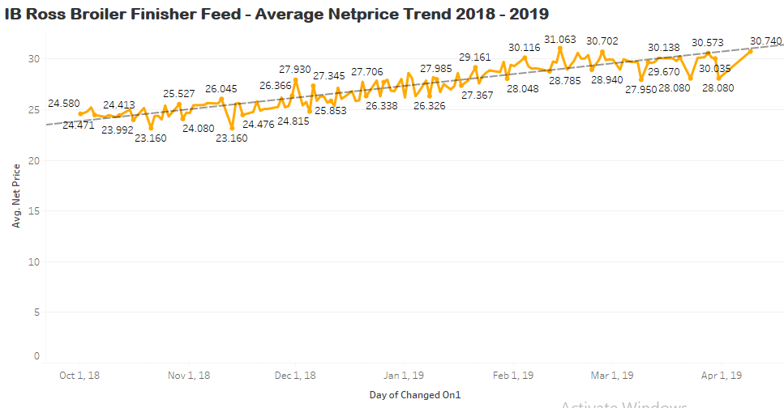
Net Price Trend for Top 5 Products
Net price were calculated for Top 25 product / item, to see the trend of the net price. However due to volume of data, only Top 5 product / Item were chosen to visualize net price pattern and forecasting since those items give highest contribution to the Gross value..
1.

Slide 13
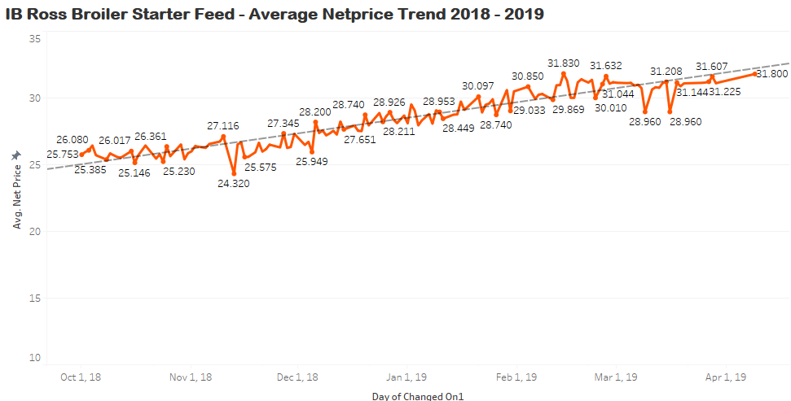
2.

Slide 14
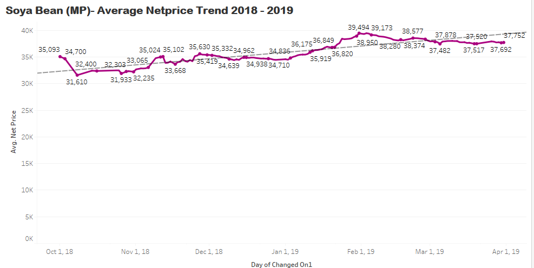
3.

Slide 15
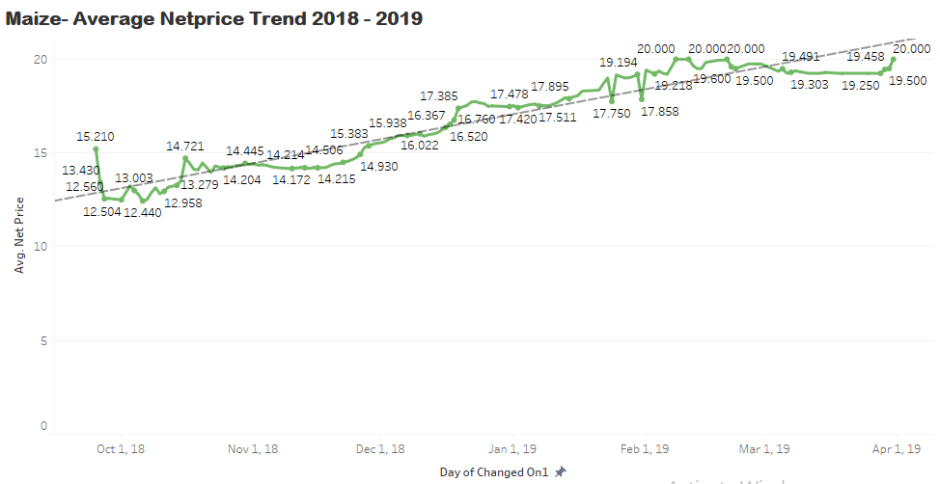
4.

Slide 16
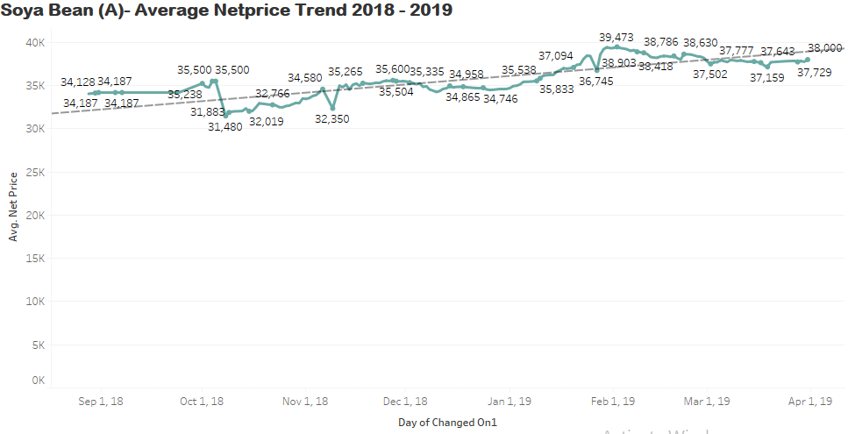
5.

Slide 17
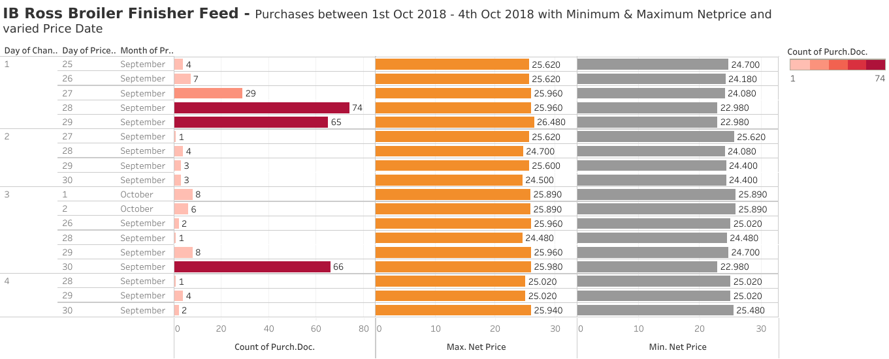
Noted Price date and net price were not constant for the purchases made during a single day for an Item. For Example: Purchases during 1/10/2018 to 4/10/2018 of IB Ross Broiler Finisher Feed item/ product were taken. Noted that purchases orders has a price range from 22.980 – 26.480 with varied price date.

Slide 18

Time series Forecasting
For the further time series forecasting, we take the Top 5 items that contributed more towards Volume(Maximum purchased) and Gross Value(Maximum Expenditure) . For the steps explanation first we will go with forecasting the net price value of Soya Bean (A) and rest 4 items follow the same procedure.
For doing time series forecasting , we filter the two columns which are Time series element and Net price from the Dataset. Since it is the only required variables for time series analysis.
Then we perform data preprocessing by assigning the respective data types to the variables.
Since our data has multiple purchases on a single date, we use group by function to group all the dates with its respective average net price value on a single date.

Slide 19
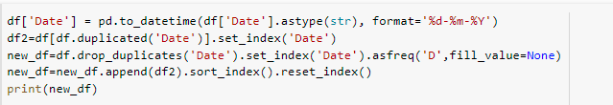

Since our data have many missing dates , the time series forecasting wont be effective. So we add all the missing dates to a given date range
Then imputed the net price value of the recently added missing date with ffill method (Forward Fill) which takes the previous value from the given observation and fills through out

Slide 20
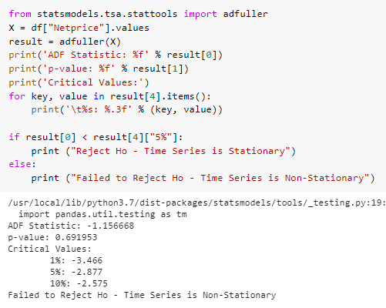
Then we check for stationarity , since we know that for doing a time series forecasting the data should be stationary.
For this we use Augmented Dickey-Fuller test .

Slide 21
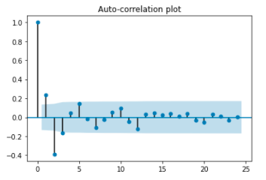
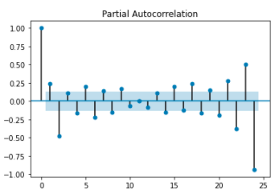
According to the Augmented Dickey-Fuller test , its clear that our data is not stationary. So we perform differencing to make it Stationary
Then for analyzing and forecasting time series data we use the statistical models named ARIMA (AutoRegressive Integrated Moving Average). To fit the Arima model ARIMA(p,d,q)” we need these three terms p, d, and q.So for finding those we use Acf and Pacf plot

Slide 22
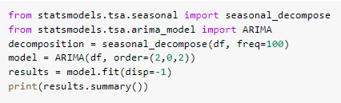

From these plots it is clear that , p=2 and q=2. Now these parameters can be used inside the Arima model
After fitting the model, then further forecasting for next 365 days

Slide 23
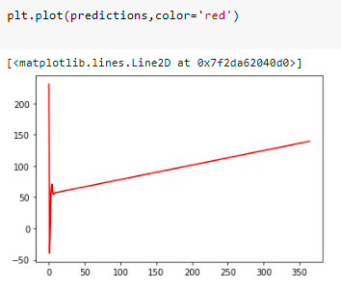
The forecasted values are in increasing trend which clearly shows that, for the material called Soya Bean (A) , the purchase will be in more in next one year.

Slide 24
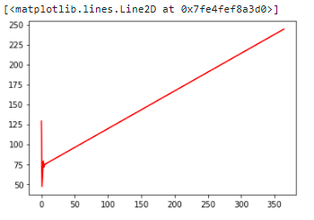
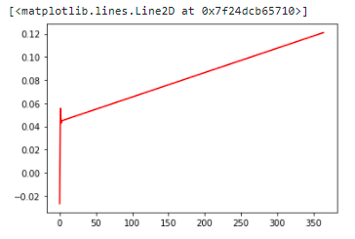
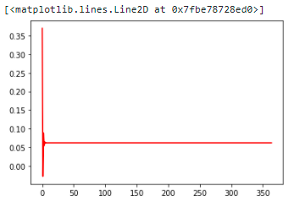
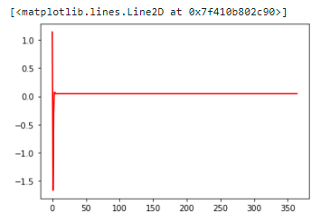
Maize
Soya Bean (MP)
IB Ross Broiler Finisher Feed
IB Ross Broiler Starter Feed

Slide 25
Clustering
Two methods were used to cluster items that have similar purchasing patterns – KModes & KMeans.
KModes:
For that first we will extract the significant columns that are used for clustering. Columns such as short text,cocd,matl group,Po quantity and gross value were taken for further clustering.
After that we will install K-Prototypes library which will do the clustering process which can handle both the categorical and Numeric variables.
Performed clustering with the range of 2 to 4 number of clusters and look for the cost function. The cost is somewhat higher.
Then performed clustering with the range of 4 to 6 number of clusters and now the cost function is lower than the previous one, hence we assume the number of clusters as 5 .

Slide 26
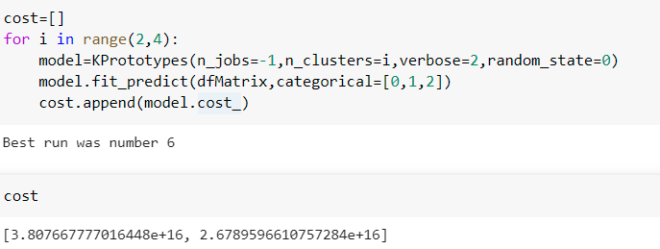
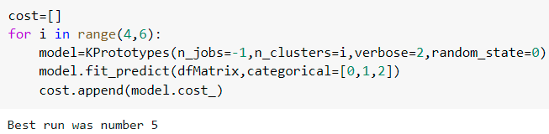

Finding out the best possible number of clusters

Slide 27
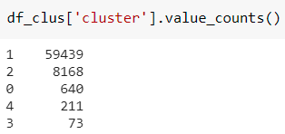
Then Run the K prototype algorithm with the no of clusters as 5 .
We got the model labels as [0,1,2,3,4], and append those model labels in the data frame as the separate column.
Cluster of materials with the similar purchase trend was identified as follows:
Clusters and its value counts:

Slide 28
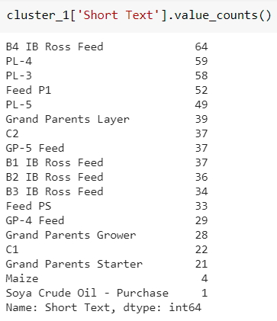
Materials with similar purchasing patterns
CLUSTER - 0

Slide 29
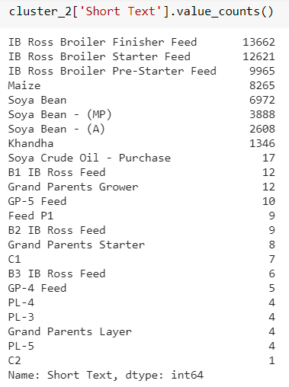
CLUSTER - 1

Slide 30
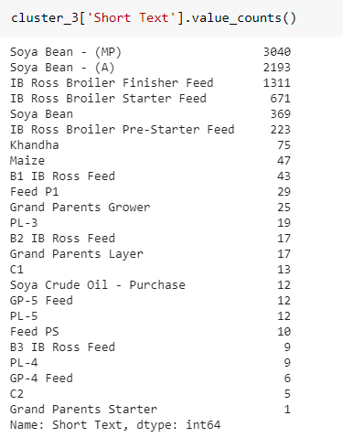
CLUSTER - 2

Slide 31
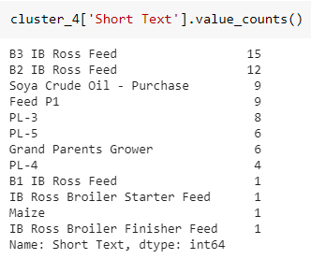
CLUSTER - 3

Slide 32
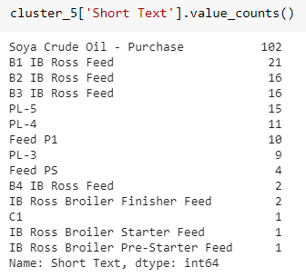
CLUSTER - 4

Slide 33
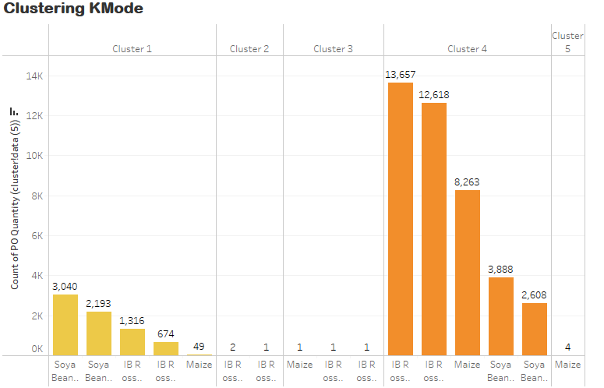

Slide 34
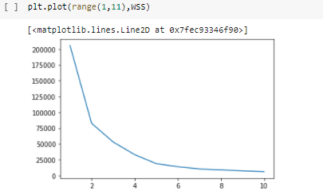
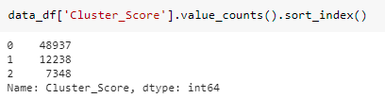
Clustering - KMeans
Clustering was performed on the data extracted with Top 25 Products/ Item that contributes to 80% > the Gross Value.
There were only 3 numerical data (PO Quantity, Net price & Gross Value) with which KMeans technique was performed.
PO Quantity & Gross Value was highly skewed (10>)and in order to normalize the skewness top 3 Method (Log, Sqrt & Boxcox) used to identify the best suit, as such Boxcox Method was used to normalize the skewness.
With the help of KMeans technique 3 cluster were created and the Silhouette Score was 0.6974452046084545.
Model labels were created for 3 clusters and the same were appended as column to the data frame.
Cluster 1, found to have more no.of highest count with similar purchase pattern.
Output was then extracted to CSV file.

Slide 35
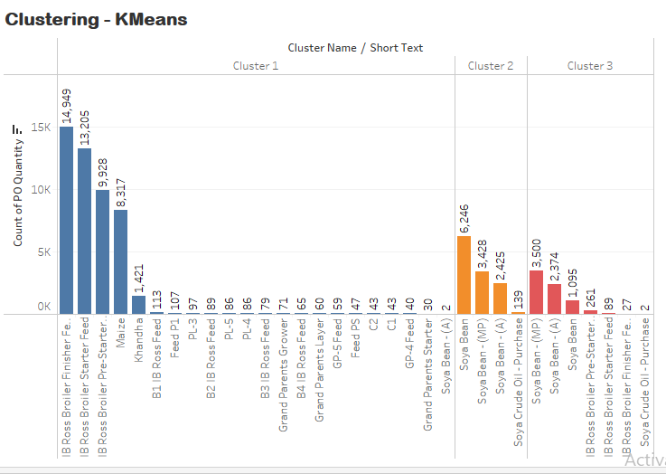
Clustering - KMeans

Slide 36
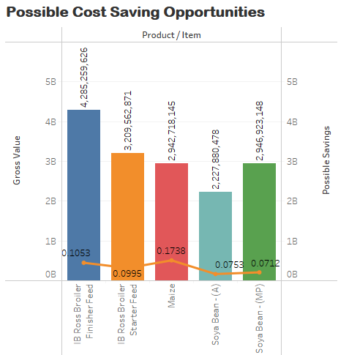
Cost Saving Opportunity
In order to find the saving opportunity, Minimum value of Net price for a specific month was taken and calculated with Purchase Order Quantity for all 25 product / items. Of which Top 5 Product/ Item has significant saving opportunity table as below. As such placing bulk purchases by Monthly (depending on the requirement) could help to reduce the cost significantly.
Soya Bean-(A), has 2 transaction with a very low net price value (6413.03) on 27th Jan 2019 however the cost of this product is above 35000 and hence this low value was not considered for evaluation.
Product / Item | Gross Value | Possible Savings | Possible Savings in %
Maize | 2,942,718,145.02 | 511,504,100.40 | 17.38%
IB Ross Broiler Finisher Feed | 4,285,259,626.41 | 451,160,023.20 | 10.53%
IB Ross Broiler Starter Feed | 3,209,562,870.62 | 319,258,431.05 | 9.95%
Soya Bean - (A) | 2,227,880,477.51 | 167,786,465.14 | 7.53%
Soya Bean - (MP) | 2,946,923,148.36 | 209,936,313.06 | 7.12%

Slide 37
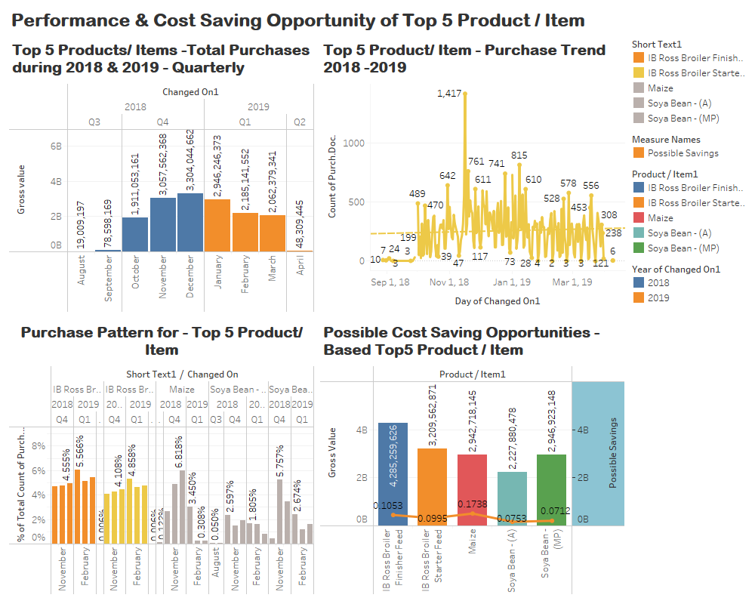
Dashboard for Top 5 materials that contributes more towards Purchase

Slide 38
Recommendations:
Consolidation of Purchase Order Request and placing in single order to could help reduce the amount of work and cost involved.
Placing bulk order could help to negotiate with vendor for better discounts.
Not sure whether the Transportation cost was included in the Gross Value / Net Price per unit. No clear information available with regards to the storage facility or capacity. Further more information required to look for better saving opportunity in terms of storage / transportation when purchased in bulk either Quarterly or Monthly.

